Slide 1

SteamConnect
Amir Sadiev, Geoffrey Blech, Michael Burke, Jonathan Mills

Slide 2
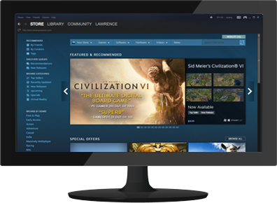
What is Steam?
Steam is a digital distribution platform developed by Valve that offers mainly multiplayer gaming services to their users.
Steam currently has over 125 million accounts, with millions online at once playing games.

Slide 3
Purpose & Data
The goal of SteamConnect will be to examine and analyze data gathered from Steam to determine trends, such as user experience, playtimes, popularity and success.
Brigham Young University Data Set - Steam user data from 2016
SteamDB - Real-time tracking and updates for Steam applications
Steam Web API - Able to access tons of information about players and games

Slide 4
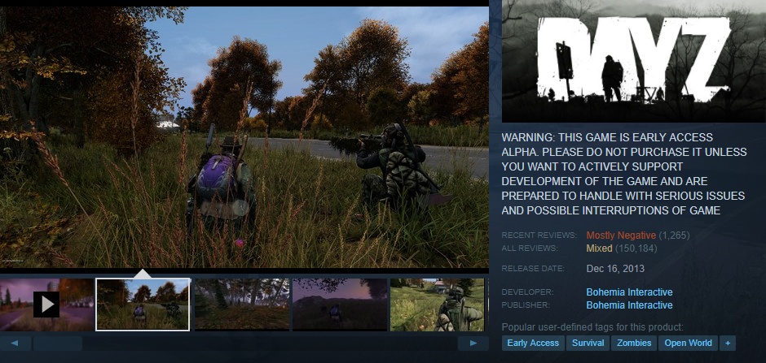
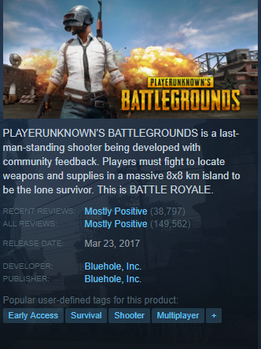
Questions Answered
Early Access games; why are they hated, what makes them work?

Slide 5
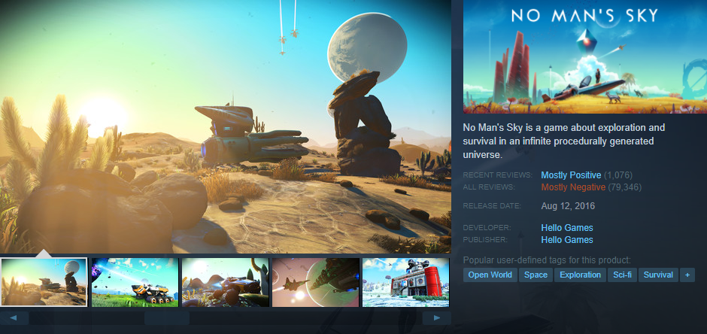
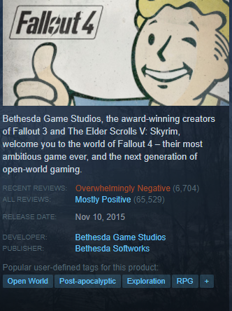
Questions Answered
All reviews vs. recent reviews; what changed, effects on current player count

Slide 6
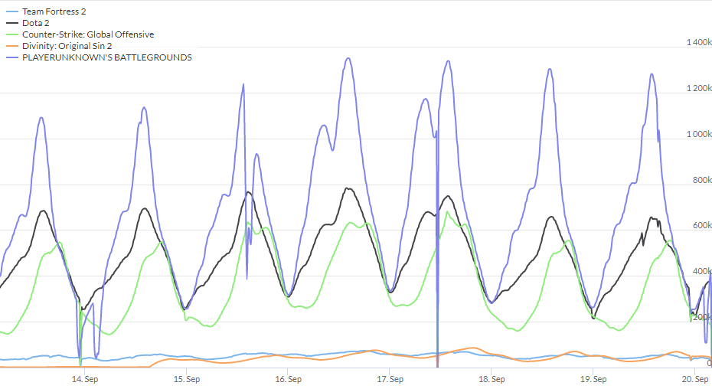
Questions Answered
User data is available
Account age
Games owned
Hours played
Badges
Level
Achievements
Money spent

Slide 7
Questions Answered
VAC Bans
“VAC stands for Valve Anti-Cheat, an automated system designed to detect cheats installed on users' computers.”
Steam Web API and websites such as VACBanned allow access to view VAC banned players, can be compared to playtimes, reviews, achievements, etc. across all VAC enabled games

Slide 8
Why does this matter?
Essentially, this is all marketing data that can be used by developers and publishers to have better success creating and marketing their games to Steam’s users.
Even AAA games can flop, and this information can help developers/publishers avoid previous mistakes based on user feedback.
Early access titles are highly exploitable, leaving easy ways out for developers to bait and switch users, grabbing their money and never finishing development.
Basically: what to do, what not to do.

